Slide 1
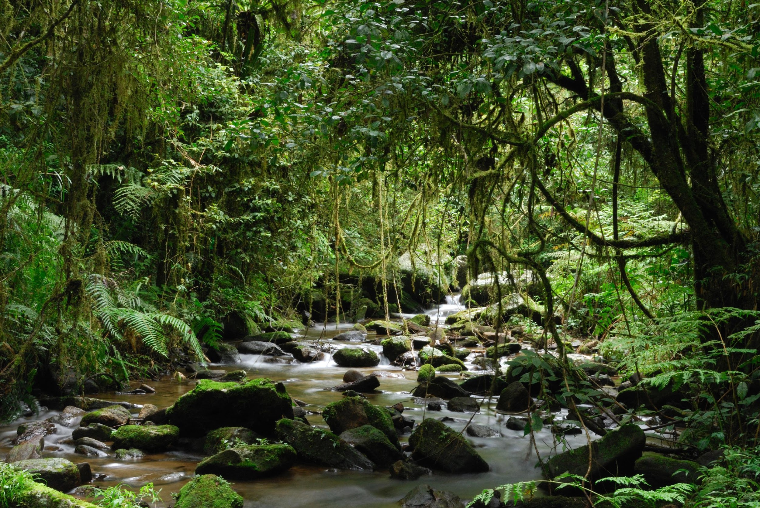
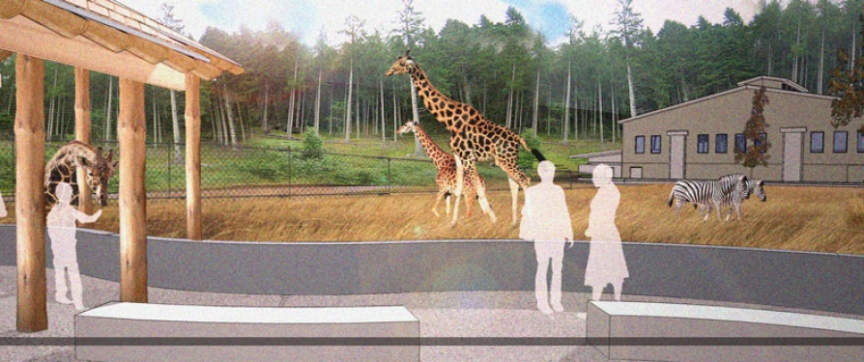
Seneca Park Zoo Society
Team 7 - Isaac Revette, Rakib Hassan, Salma Abdelhamid, Guilherme Plentz de Liz, Ryan Page, Ilia Isaikin

Slide 2
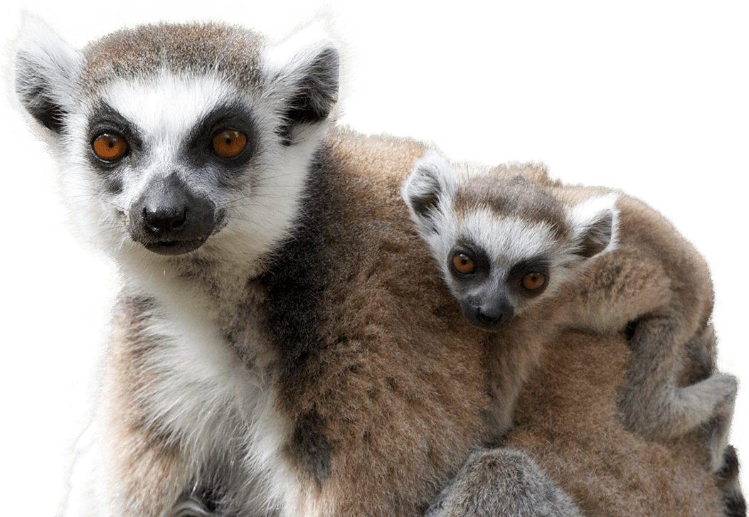
Agenda
Vision and Objectives
What We’ve Done
3rd Party Data
Demographics
Geospatial
Disasters
Lemurs
Proposed ERD for New Data
Deliverables
Summary
Questions & Discussion

Slide 3

Vision and Objectives
Vision of connecting Seneca Park donors to their donations
Objectives based on Sponsor requests:
Finding new sources of relevant datasets.
Defining the methodology for tracking and updating new sources.
Creating a storage format for data sets.
Visualizing that data using GIS and visualization software.

Slide 4

What We’ve Done
Cleaned and explored Seneca Park data
Identified need for data enrichment
Collected 3rd Party data
Identified ways to connect new data to reforestation donations

Slide 5
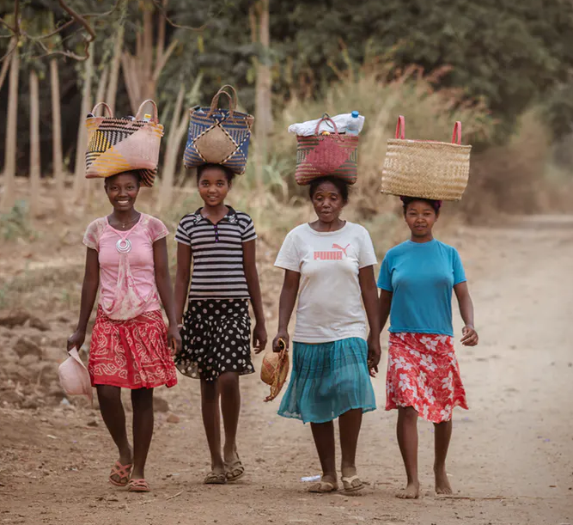
Demographic Data
What
Collected data on 32 demographic measures, such as:
Rural and Urban populations
Literacy Rates
Aid per capita in US Dollars
Access to electricity
Transformed and merged into one time-series csv file
Why
Allows for donors to learn more about the country they are donating to help
Highlights reasons for necessity of aid like reforestation

Slide 6
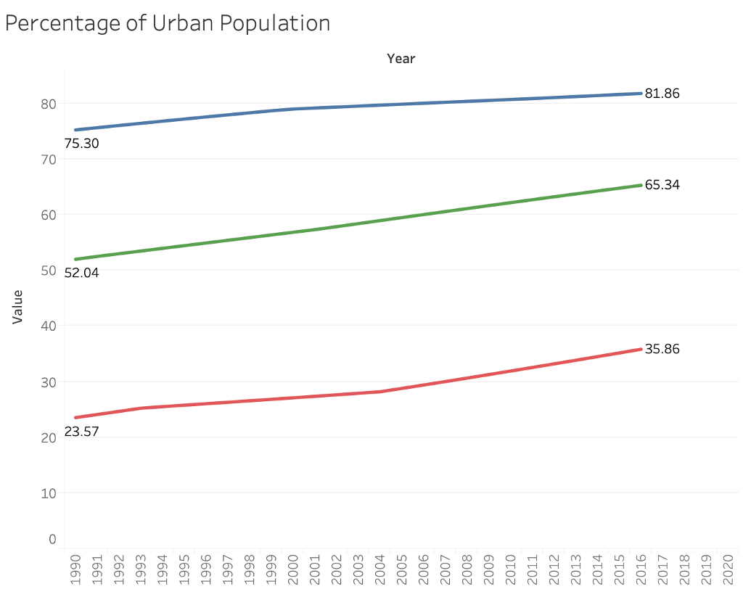
Madagascar is urbanizing
Madagascar
South Africa
United States
Source: https://ourworldindata.org/grapher/aid-received-per-capita?tab=chart&time=2000..2016&country=MDG

Slide 7
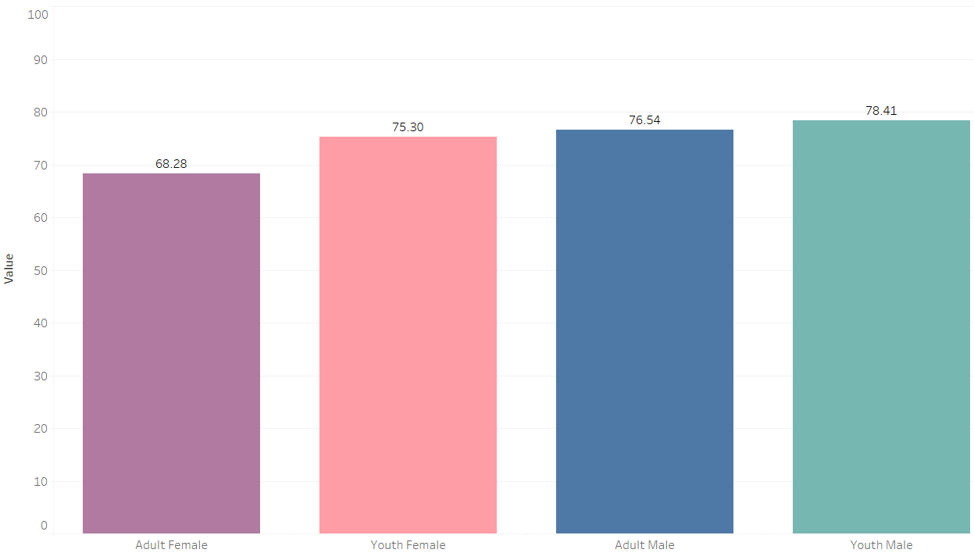
Low Literacy Rates in Madagascar
99%
Literacy Rate
USA
* Adult >= 15 > Youth
Source: https://ourworldindata.org/grapher/aid-received-per-capita?tab=chart&time=2000..2016&country=MDG

Slide 8
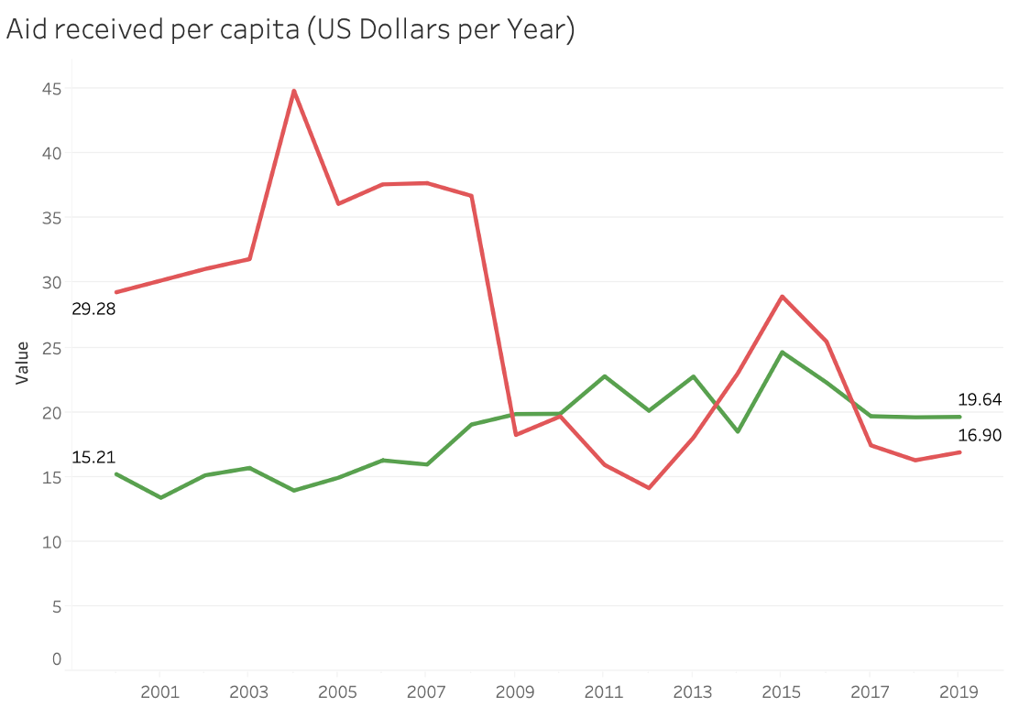
Reduced Aid to Madagascar
Madagascar
South Africa
Source: https://ourworldindata.org/grapher/aid-received-per-capita?tab=chart&time=2000..2016&country=MDG

Slide 9
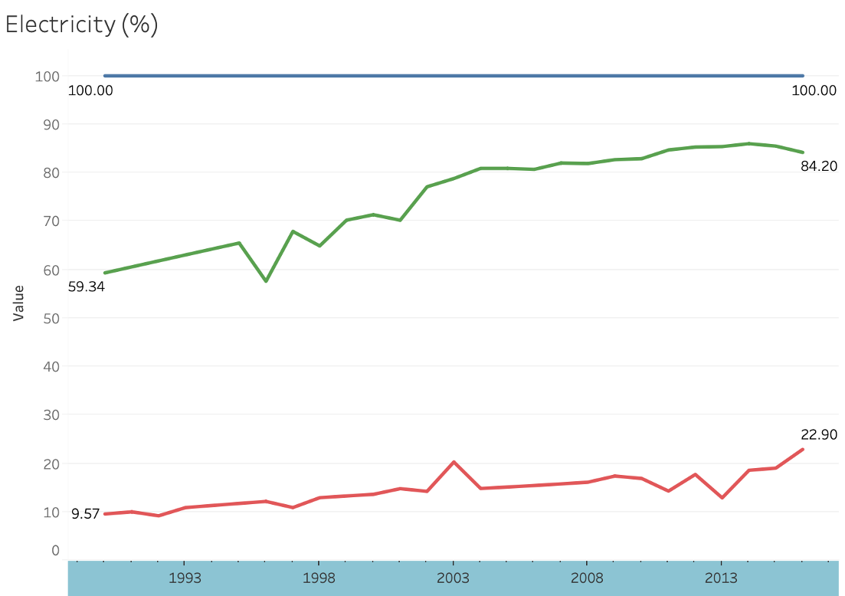
Extremely Low Access to Electricity
Madagascar
South Africa
United States
Source: https://ourworldindata.org/grapher/aid-received-per-capita?tab=chart&time=2000..2016&country=MDG

Slide 10

Geolocational Data
What
Collected data on locations throughout Madagascar:
Population
Elevation
Temperature
Rainfall
Aggregated (‘91 to ‘16) to find seasonal averages
Why
Donors are interested in the climate in Madagascar
Deforestation causes Global Warming

Slide 11
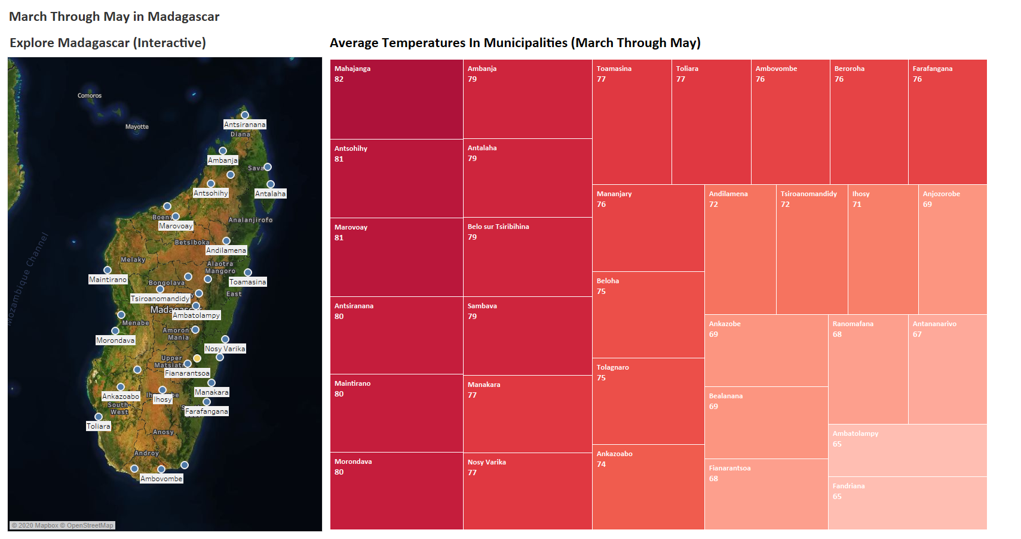
Geolocational: Dashboard (Temp.)
Source: https://climateknowledgeportal.worldbank.org/download-data

Slide 12
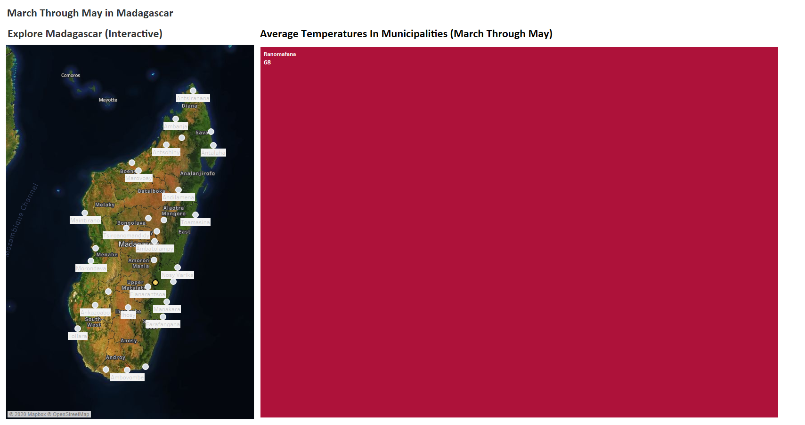
Geolocational: Dashboard (Temp.) Zoomed In
Source: https://climateknowledgeportal.worldbank.org/download-data

Slide 13
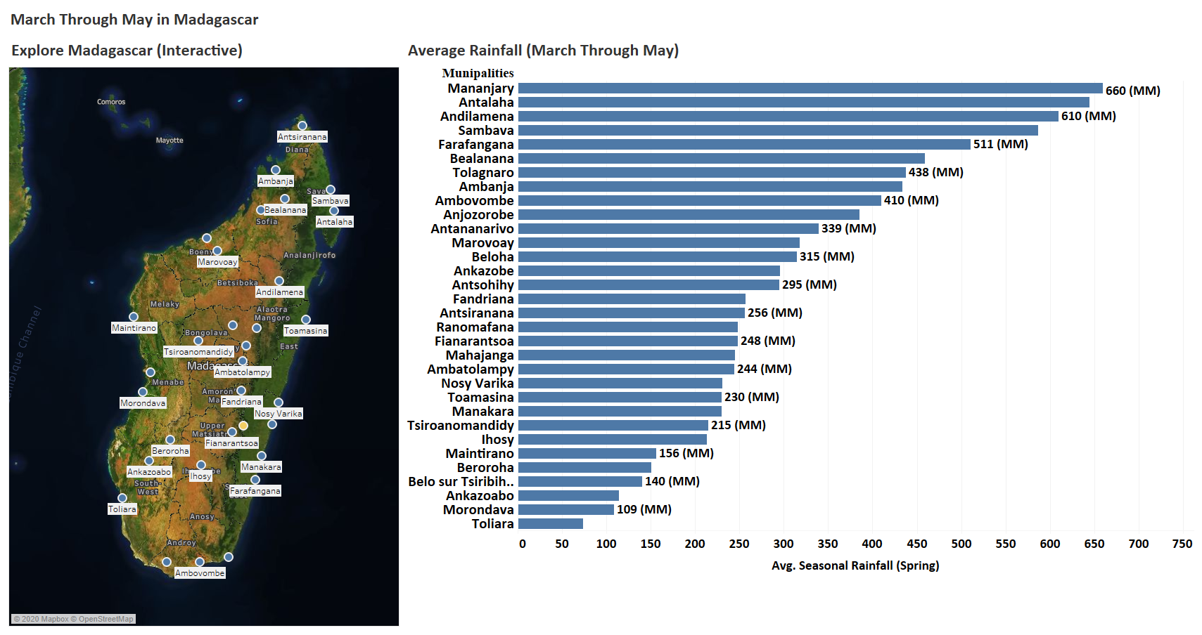
Geolocational: Dashboard (Rain)
Source: https://climateknowledgeportal.worldbank.org/download-data

Slide 14
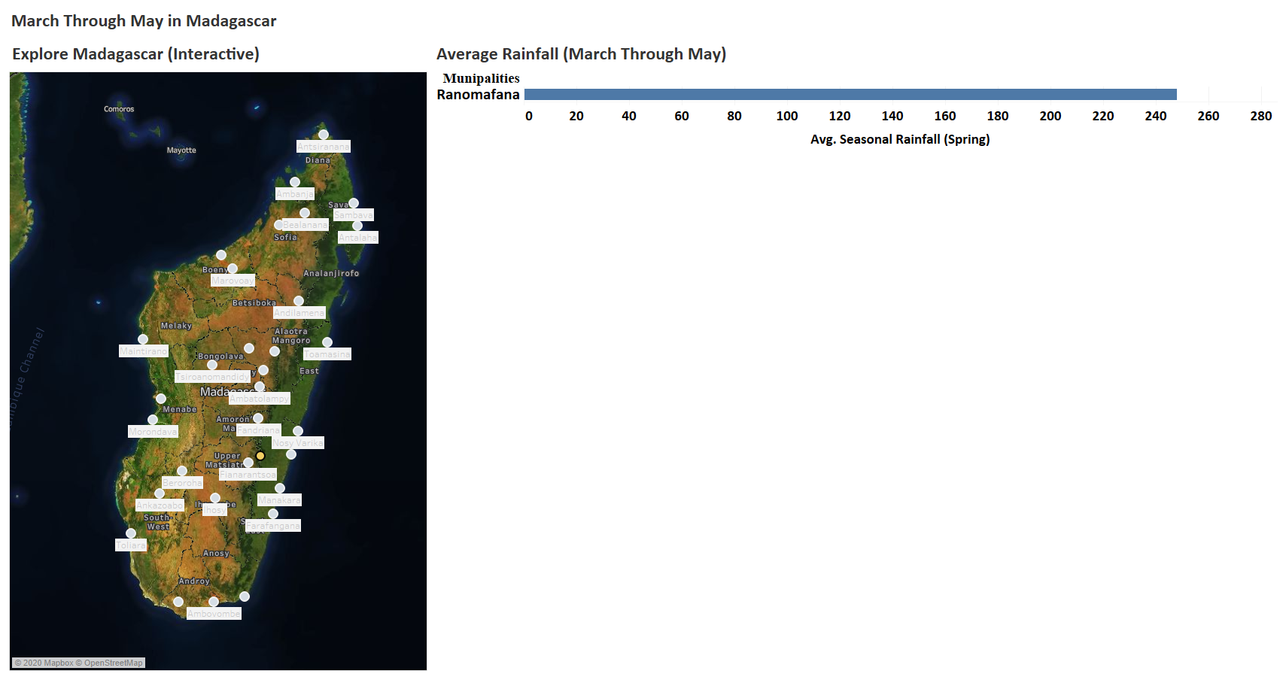
Geolocational: Dashboard (Rain) Zoomed In
Source: https://climateknowledgeportal.worldbank.org/download-data

Slide 15
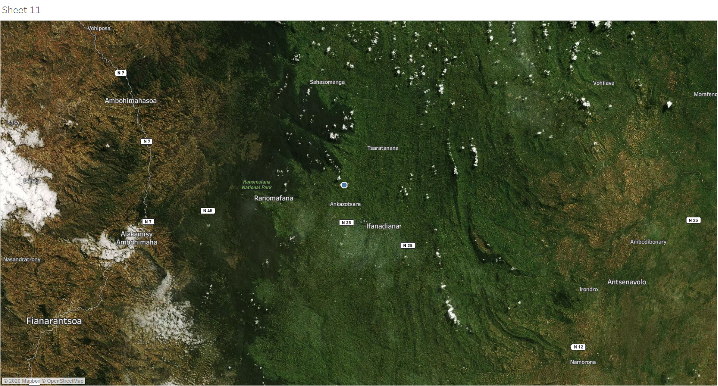
Where Are Trees Planted?

Slide 16
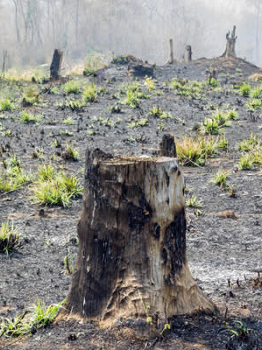
Environmental Disasters Data
What
Collected data on 11 measures of environmental disaster damage, such as:
Deaths
Injured
Houses Destroyed, etc.
Transformed Date field and removed outliers from key measure columns
Applied One-Hot encoding to ‘Event’ column and estimated correlations between variables
Why
Disasters destroy the environment throughout Madagascar
Deforestation results in more environmental disasters

Slide 17
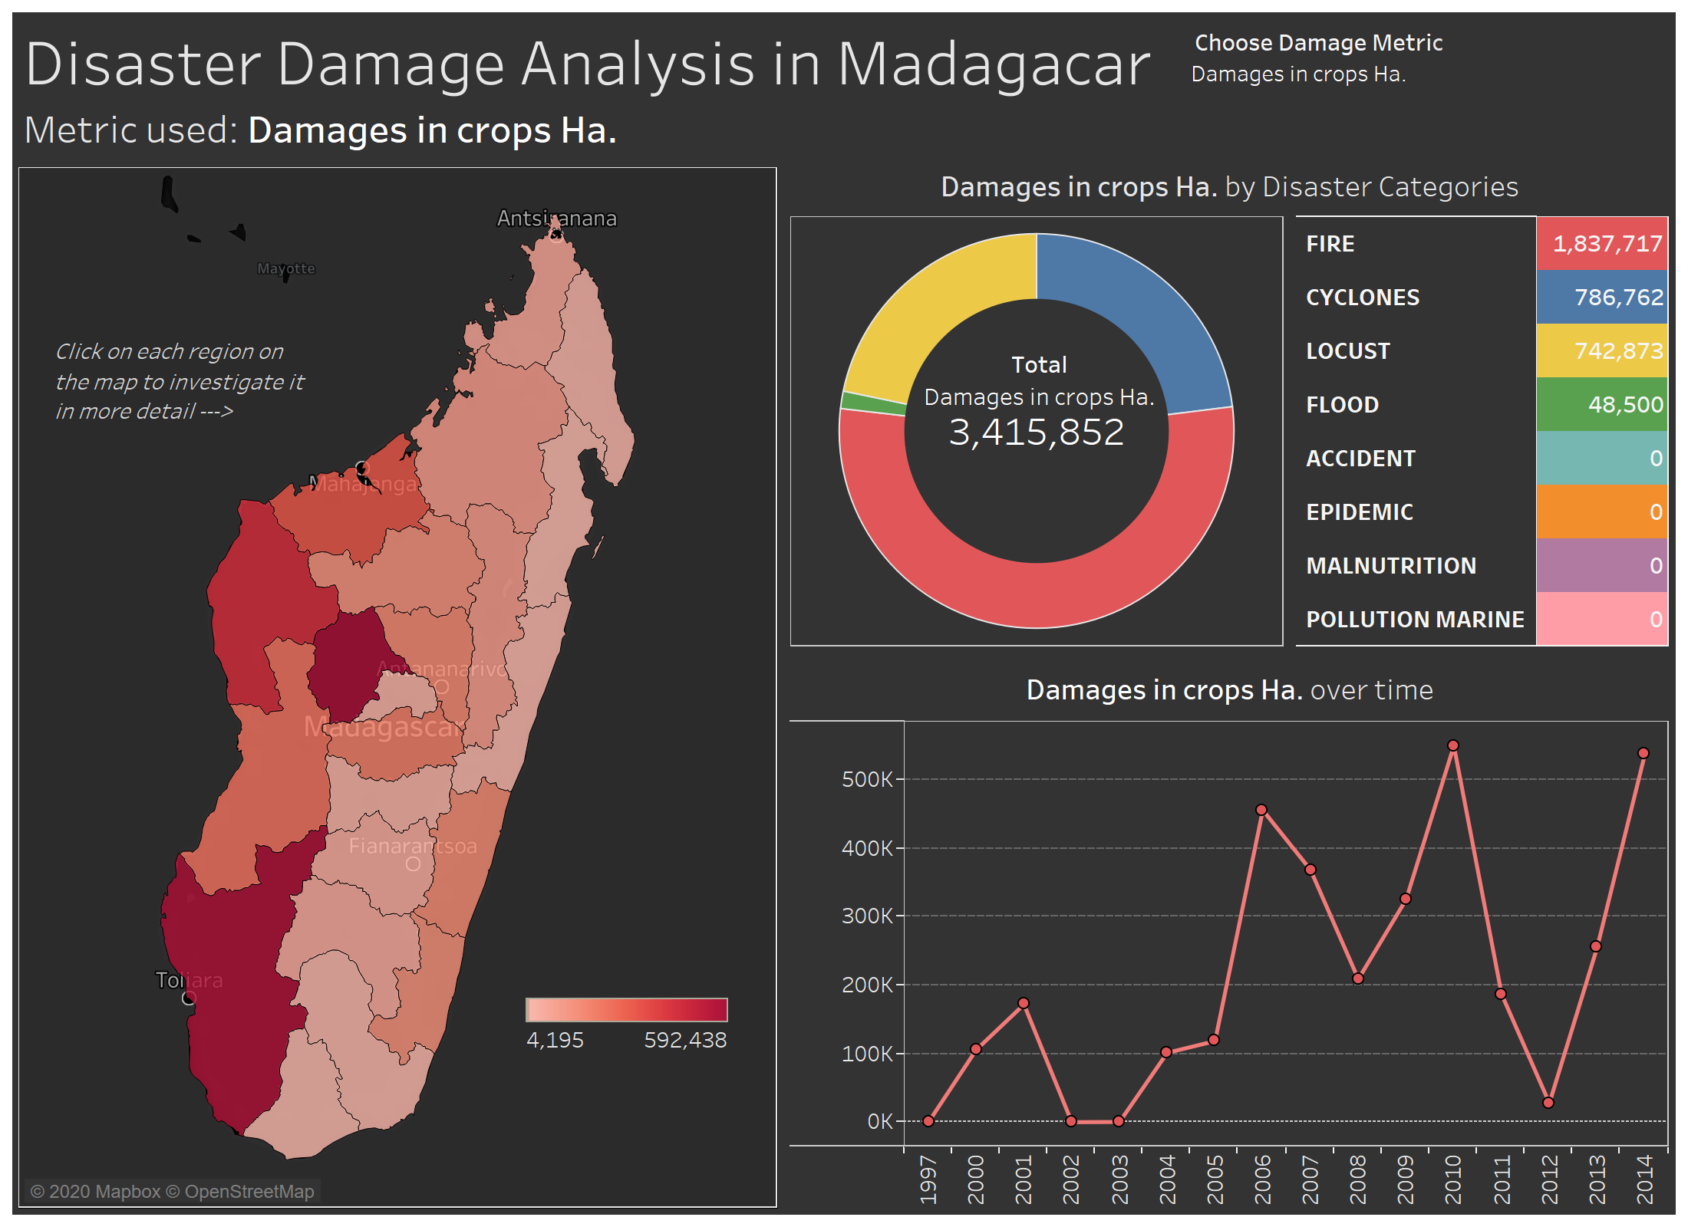
Disasters Data: Dashboard (Interactive)
The Dashboard summarizes information on:
Overall damage from different disasters by 8 metrics
Areas of Madagascar that suffered the most
Damage over time
Key insights:
More than 2 million people were injured by disasters over 20 years
Over 400 thousand houses were destroyed
The total damage exceeded 1 billion US dollars
Source: https://data.humdata.org/dataset/climate-change-impact-in-madagascar

Slide 18
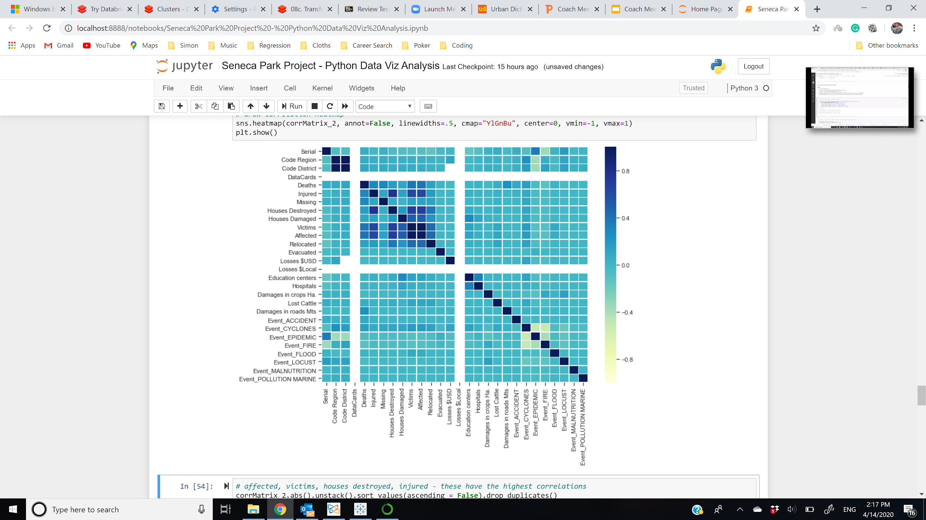
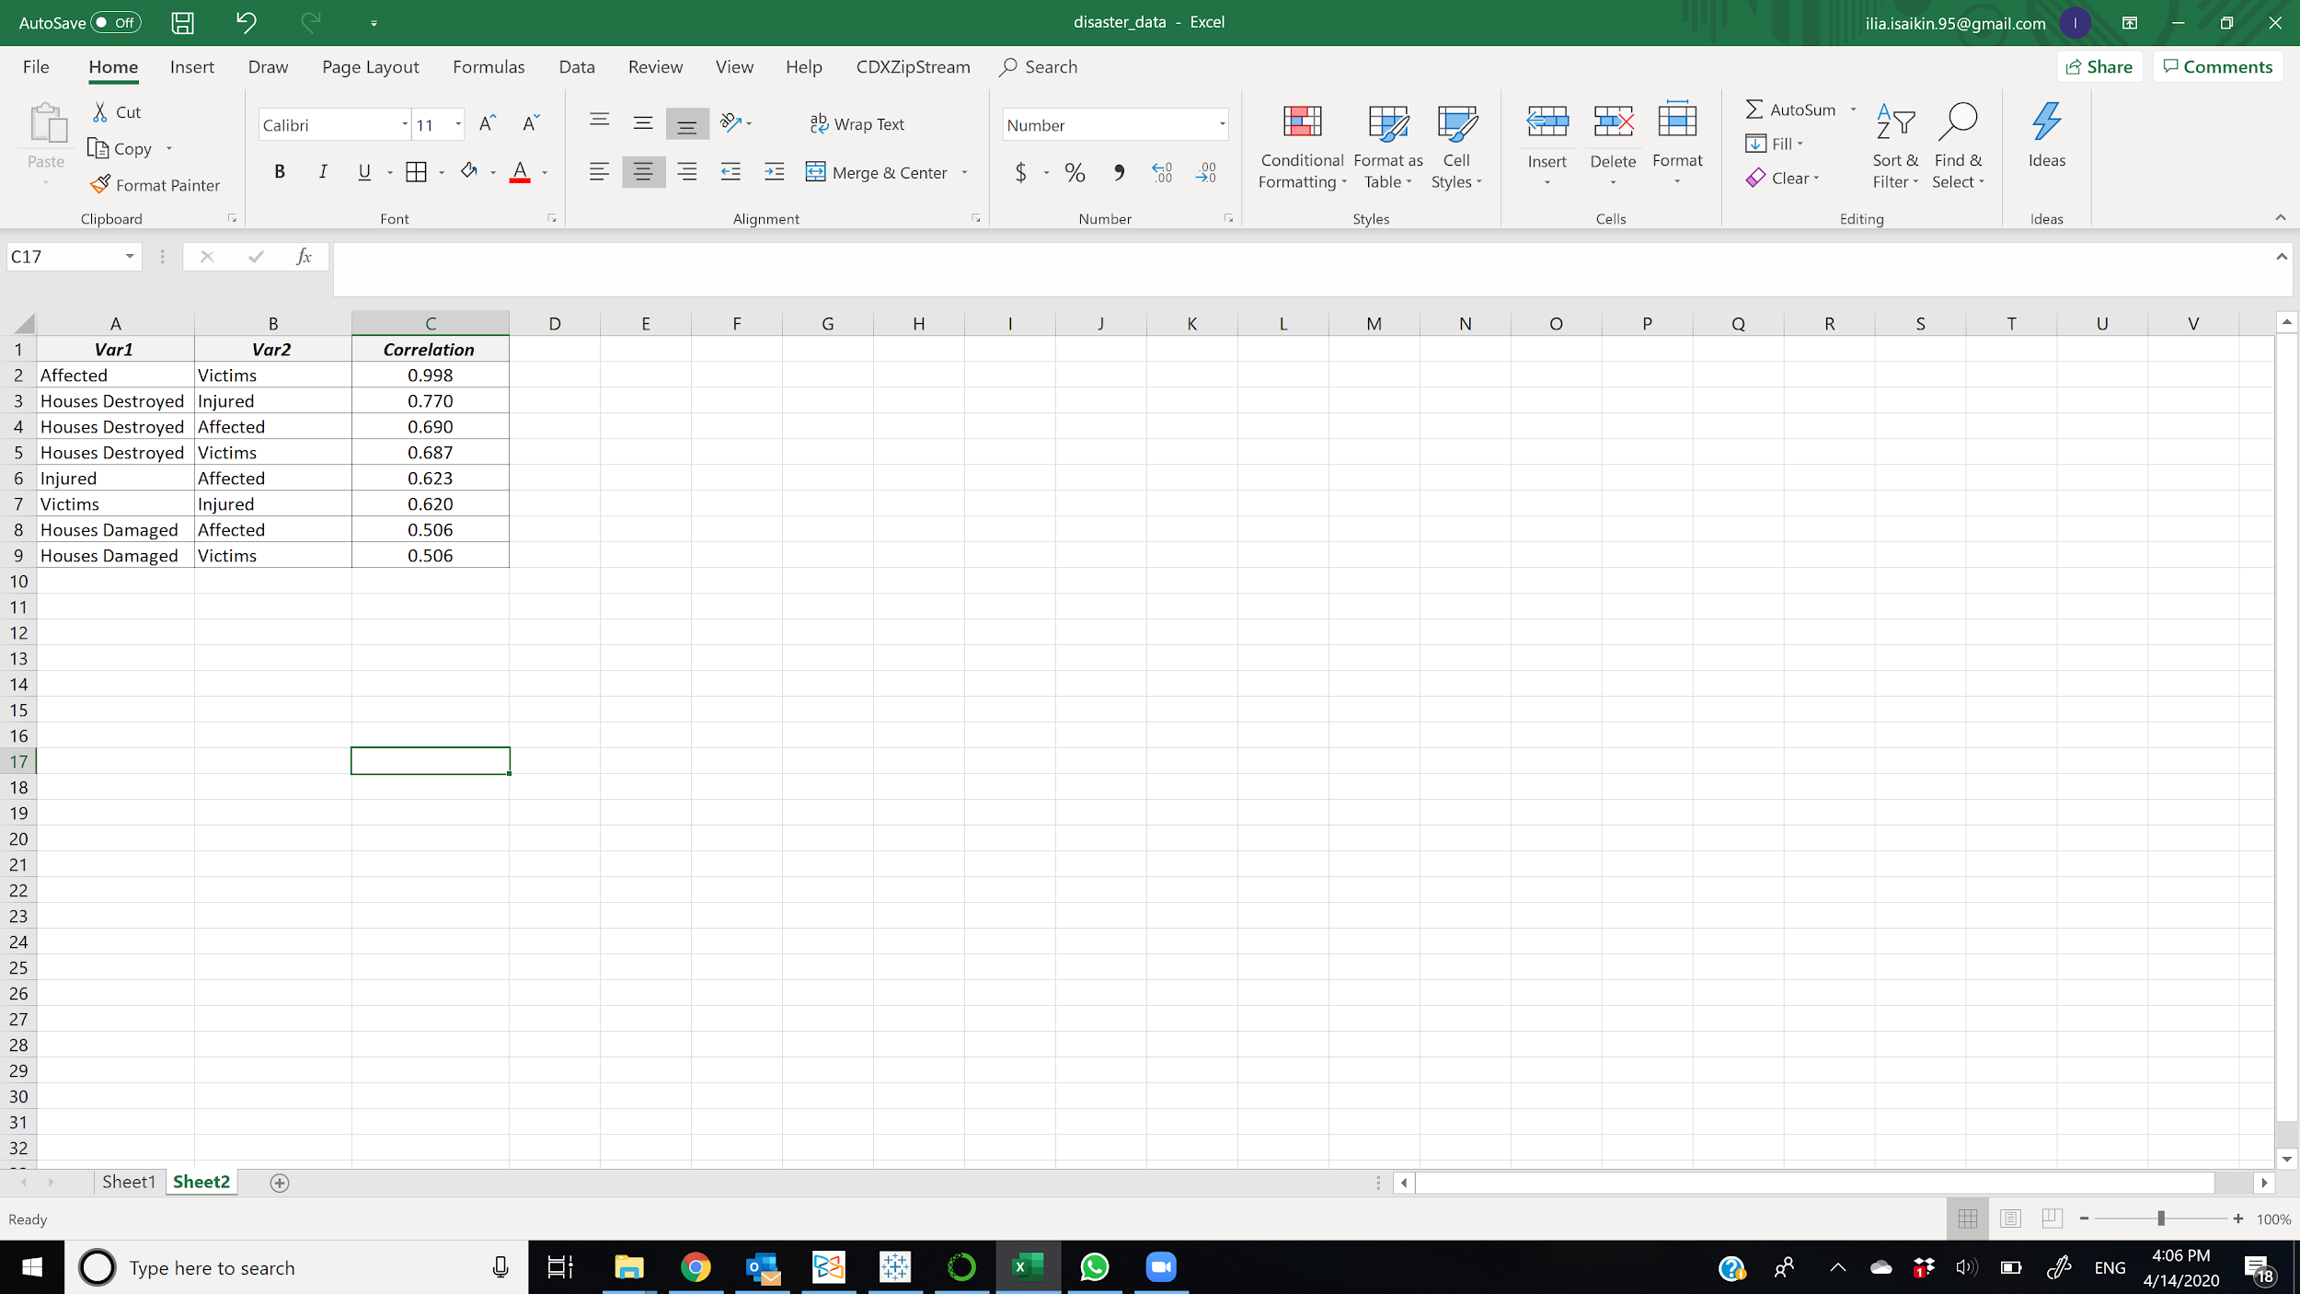
Disasters Data: Correlation Heat Map
Variables with the highest correlation are 4 disaster damage metrics:
Affected
Victims
Injured
Houses Destroyed

Slide 19
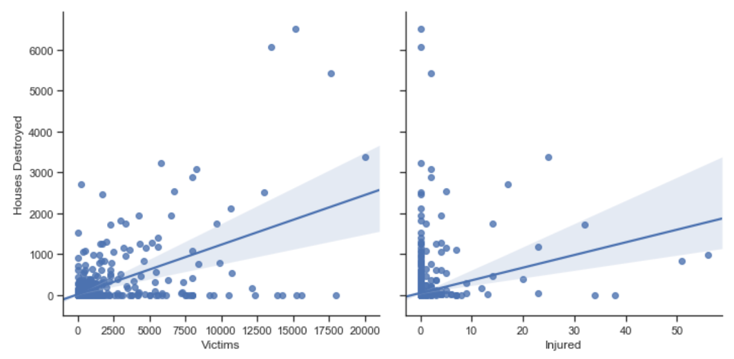
Disasters Data: Scatter Plots
The measures of damage to people and property are positively correlated, which means most events affected both population and infrastructure.
On average, each disaster caused damage to 5000 people and 200 houses.

Slide 20


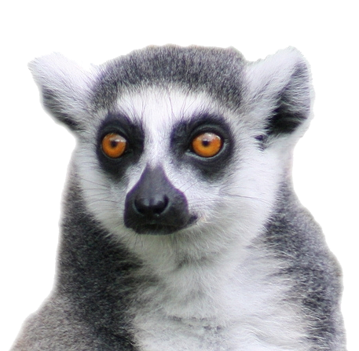
Lemurs
When I mention that my final project is about data from trees in Madagascar, and how to keep donors engaged, people right away say: “Lemurs?!” “Madagascar, the movie?!”
Best way to keep our donors happy and engaged → give them a face attached to their donation

Slide 21
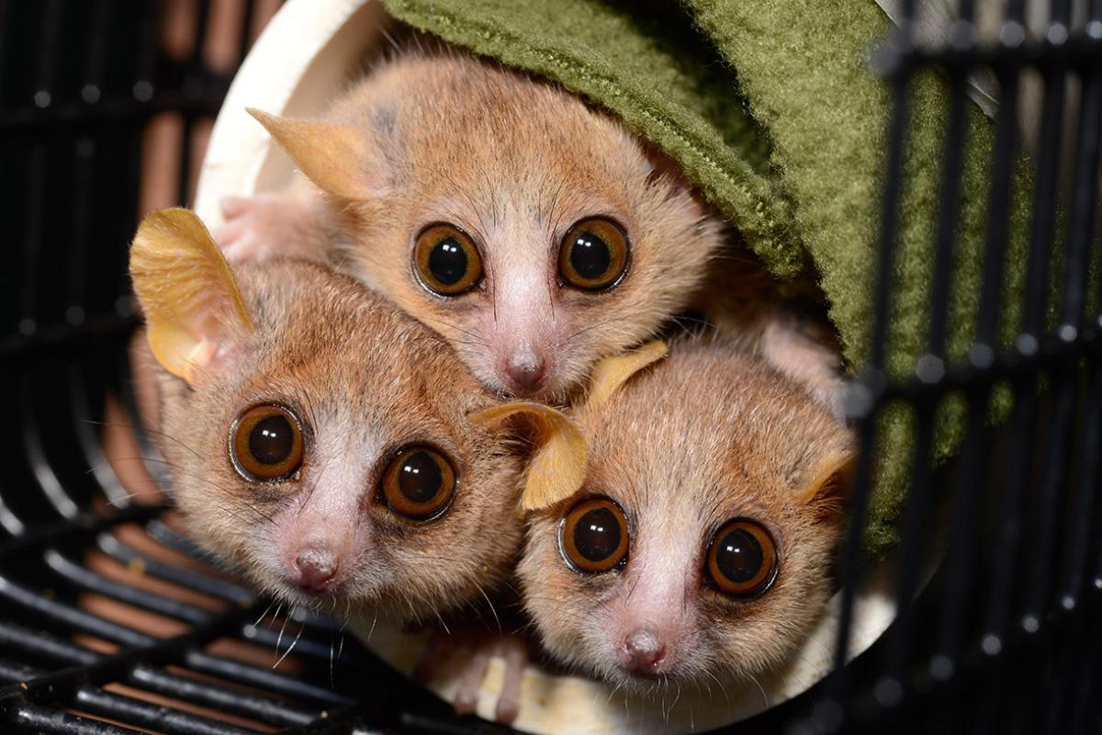
Lemur Data
Duke Lemur Center: world leader in the study, care, and protection of lemurs.
Analyzed data for ~3,700 lemurs.
From 2014 to 2019, the lemur population increased by 3.5%.

Slide 22
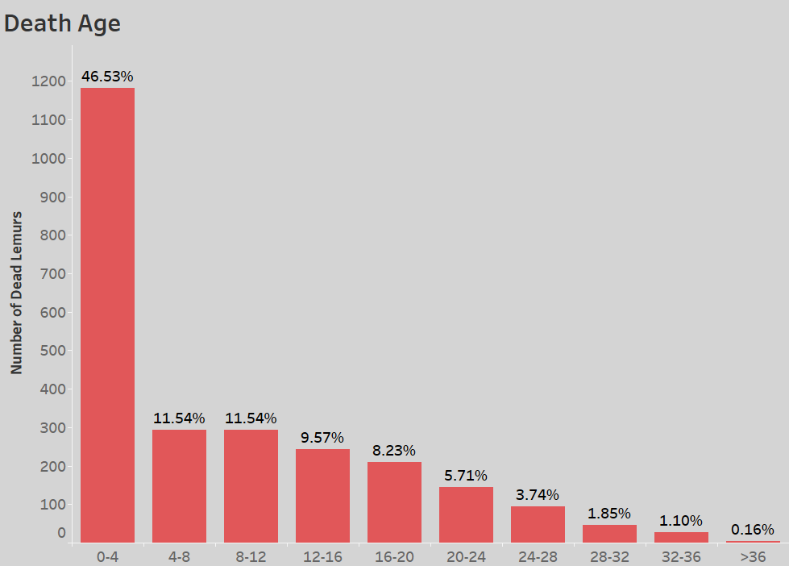
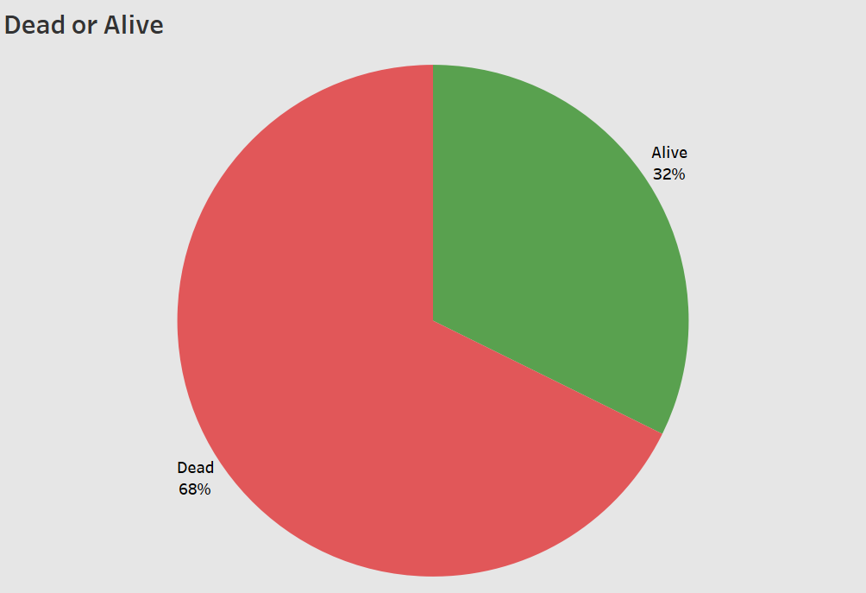
Lemurs: Mortality Rate
Baby lemurs are at the highest risk of death.
Source: https://lemur.duke.edu/duke-lemur-center-database/

Slide 23
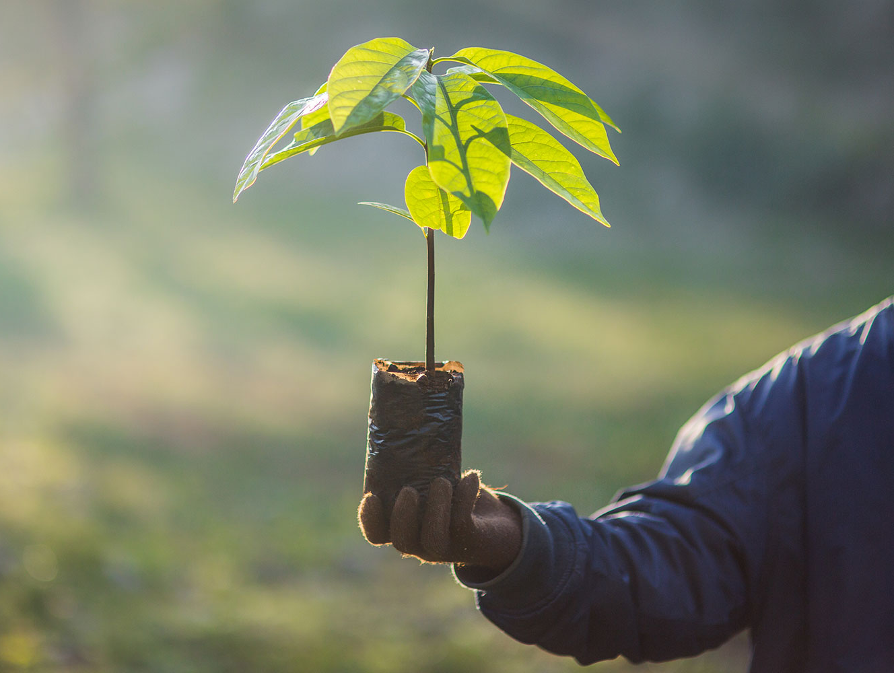
How Planting Trees Can Save Lemurs
Source: https://www.ecowatch.com/planting-trees-can-save-lemurs-2642214700.html?rebelltitem=3#rebelltitem3
Madagascar has lost nearly half (44%) of its forests within the last 60 years
Deforestation alone could eliminate lemurs' entire eastern rainforest habitat
Lemurs depend on habitat cover to survive
Reforestation provides lemurs a habitat to hide from predators

Slide 24
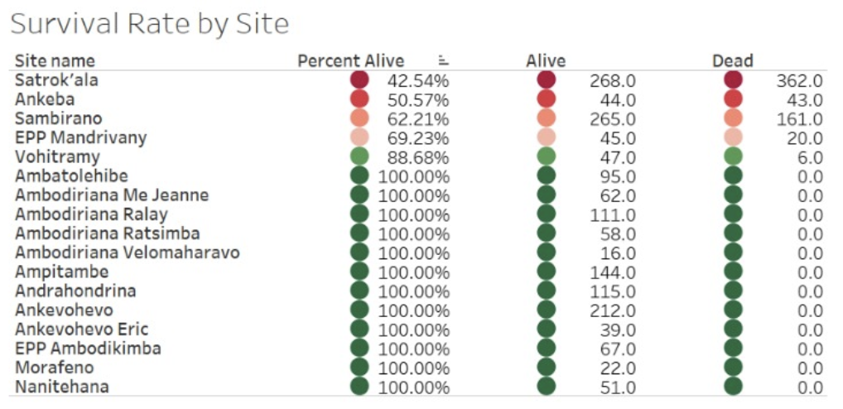
Seneca Park Zoo’s Efforts Are Successful!
The majority of tree-planting sites have a survival rate of 100%
There are some sites we’ve identified as in danger:
Satrok’ala
Ankeba
Sambirano
The survival of trees is vital for the protection of lemurs
Source: https://climateknowledgeportal.worldbank.org/download-data

Slide 25
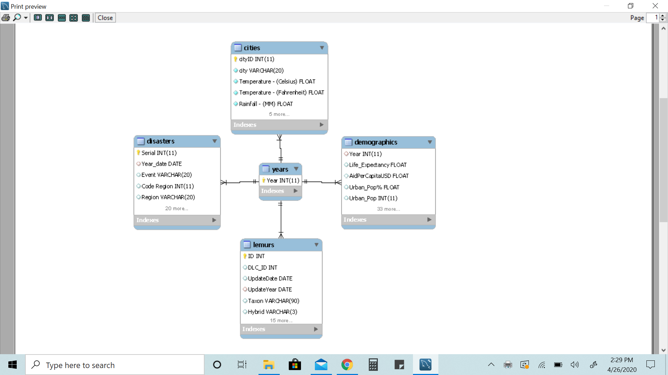
Data Warehouse ER Diagram
Relationships:
Years to disasters (one-to-many)
Years to Cities (one-to-many)
Years to Demographics (one-to-one)
Years to Lemurs (one-to-Many)

Slide 26
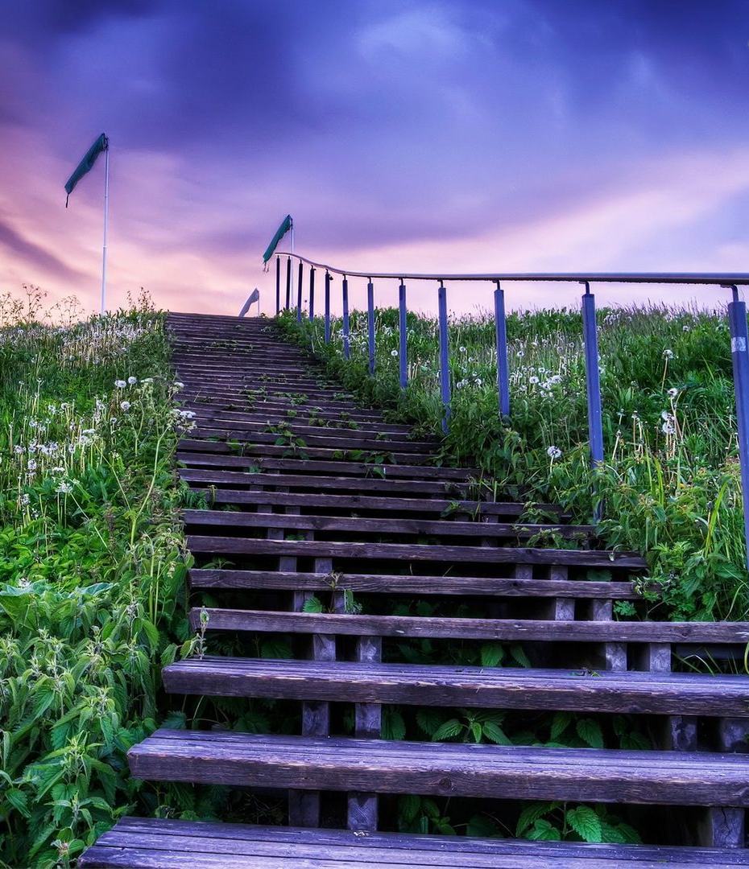
Going Further
We have visualizations that will increase donor awareness of Madagascar
We have formalized the data gathering steps in a written document
You will have access to a MySQL data warehouse
Other analysts can use this data to advance your tree-planting efforts in the future

Slide 27

Deliverables
Formatted data
Methodology for updating data
ER Diagram for data
MySQL Script to create ERD
Tableau Workbooks

Slide 28
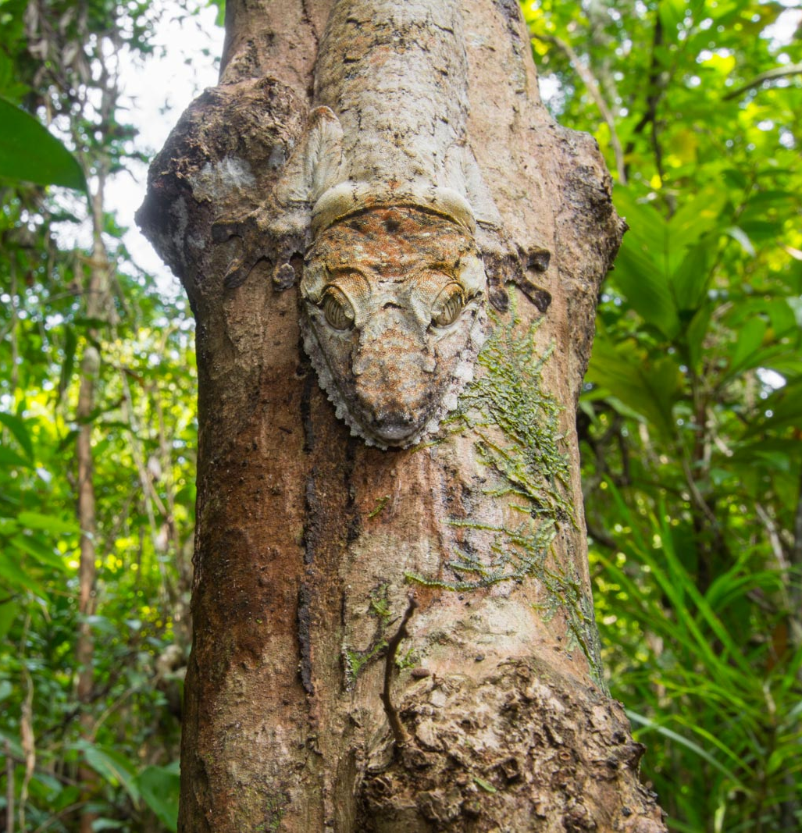
Summary
Use enriched data to connect donors:
Demographics → Connect to the people of Madagascar
Geolocational → Show donors what living in Madagascar is like
Disasters → Deforestation causes Climate Change
Lemurs → Planting a tree can save lives of animals

Slide 29
Questions & Answers

